Slide 1
The Progressives
Topics to be covered:
Muckrakers/reformers
Labor movement
Government reforms
Women’s suffrage
Roosevelt
Taft
Wilson

Slide 2
The Reformer
Urban
Middle/Upper Class
Well educated
Native born

Slide 3
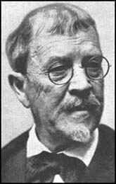
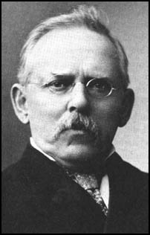
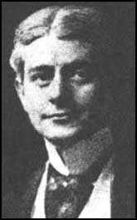
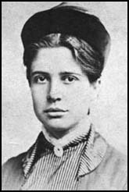
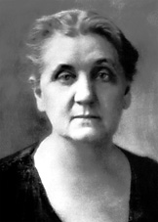
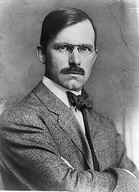
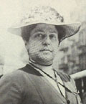
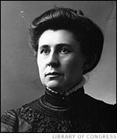
Progressive Reformers:
Lincoln Steffens
Florence Kelley
Frank Norris
Jacob Riis
Jane Addams
Lillian Wald
Ida Tarbell
Ray Stannard Baker

Slide 4
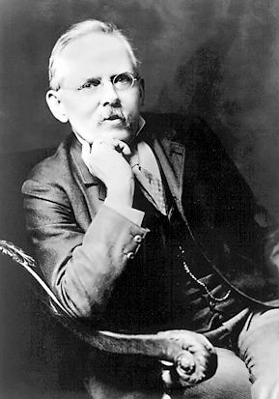
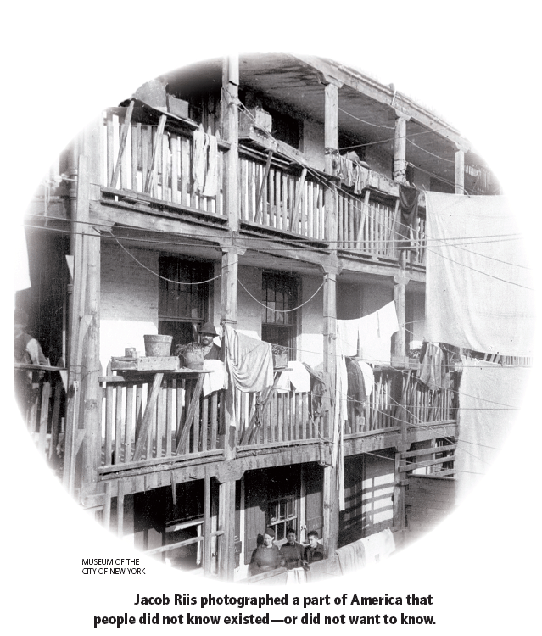
Jacob Riis How the Other Half Lives

Slide 5
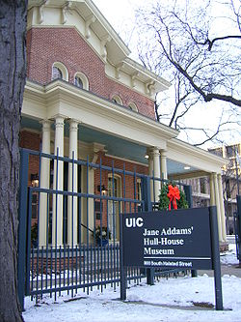
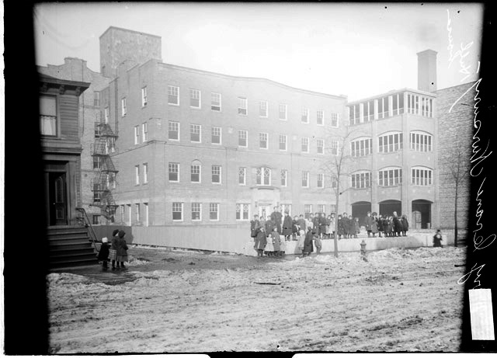
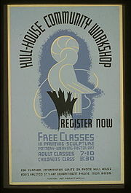
Jane Addams, Hull House

Slide 6
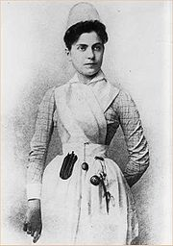
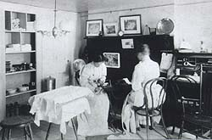
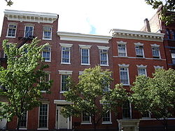
Lillian Wald, Henry Street Settlement

Slide 7
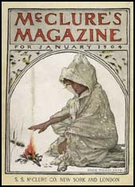
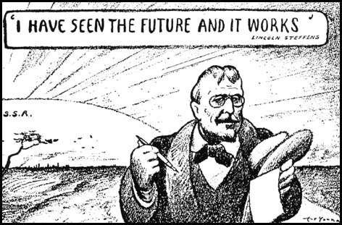
Lincoln Steffens, The Shame of the Cities

Slide 8
Ray Stannard Baker
Ida Tarbell
Florence Kelley
Frank Norris
Lynching
The History of Standard Oil
Labor, children’s rights
The Octopus (farmers v. the railroads)

Slide 9
Labor Reforms:
Child labor laws
Ban child labor
National Child Labor Committee
Limit women’s labor
Minimum wage (not until 1938)
Fire codes (in NY)
Result of Triangle Shirtwaist Fire

Slide 10
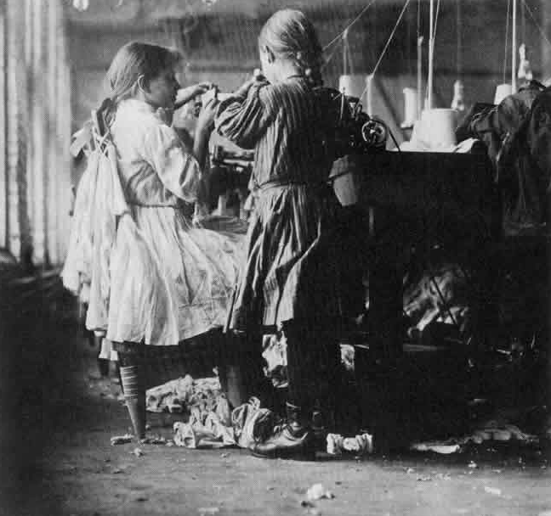
Child Labor

Slide 11
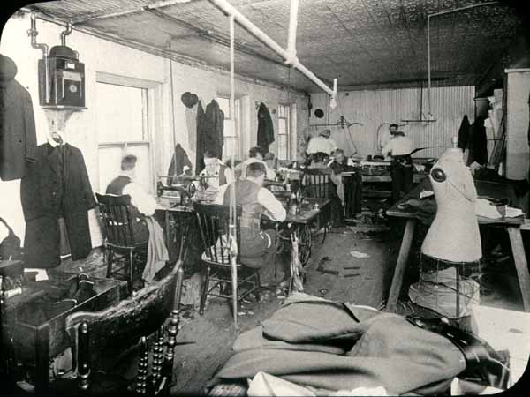
Sweatshops

Slide 12
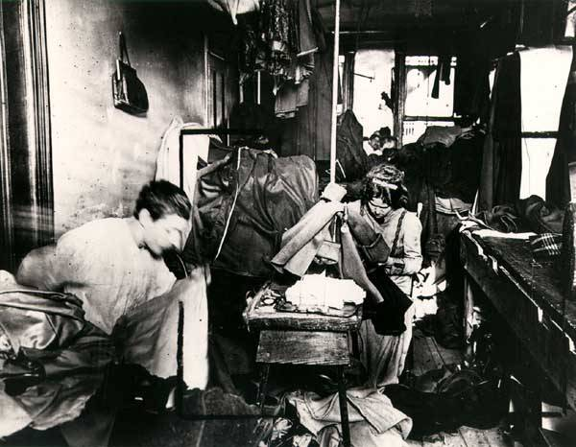

Slide 13
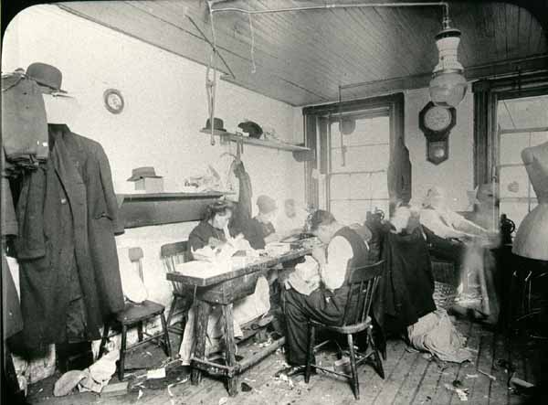

Slide 14
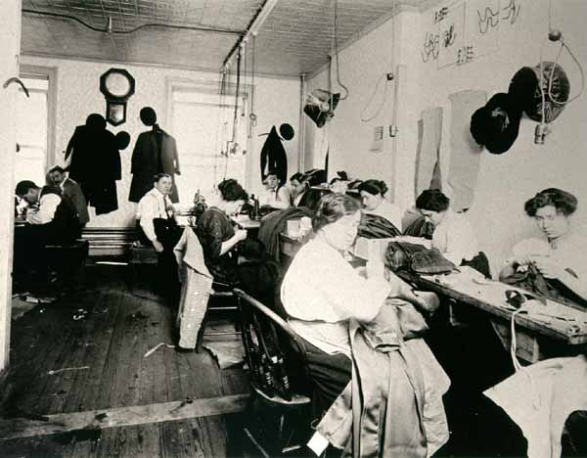

Slide 15
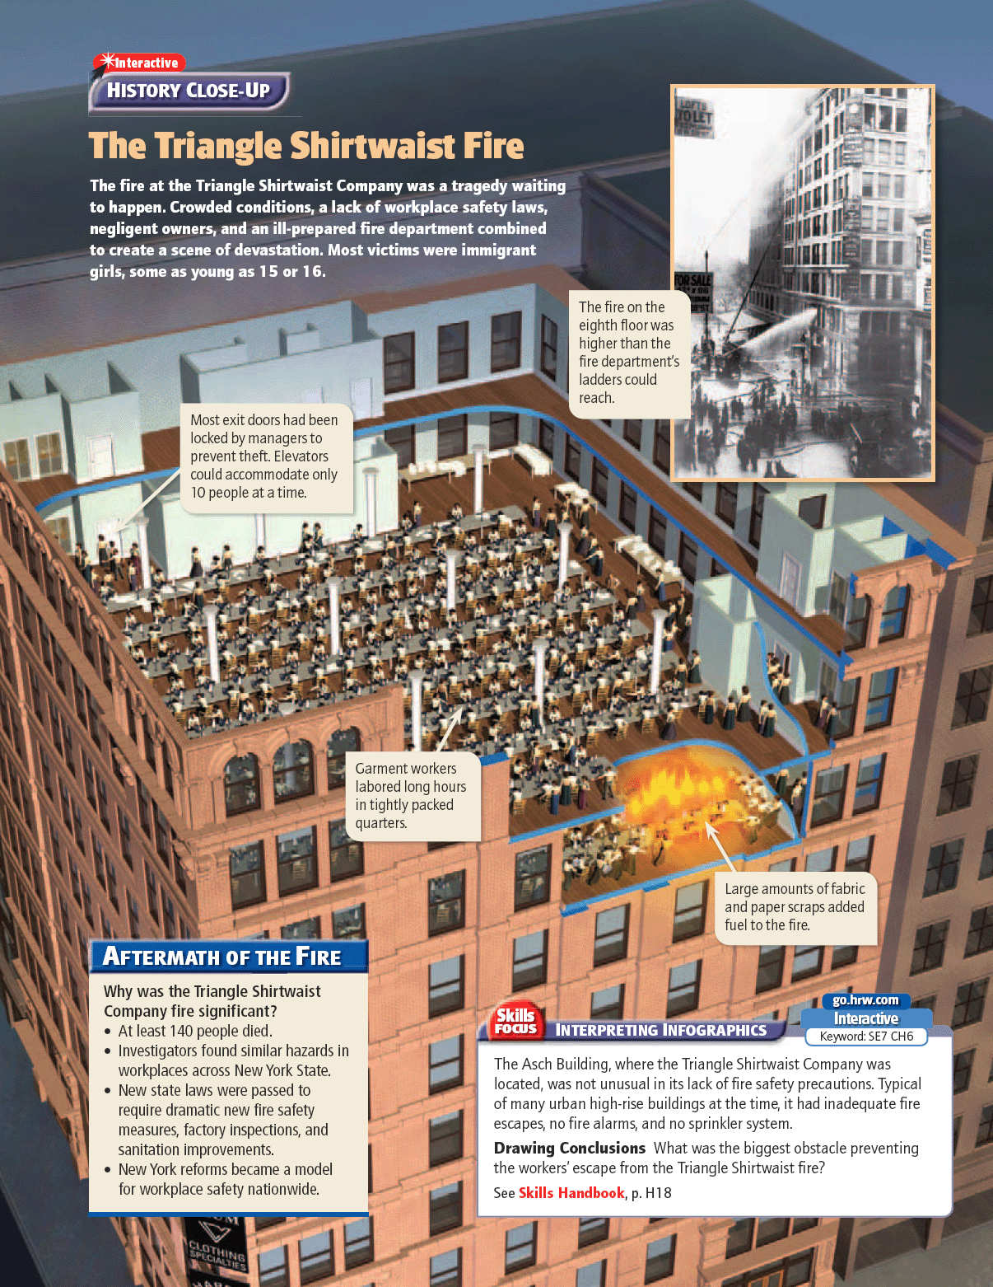
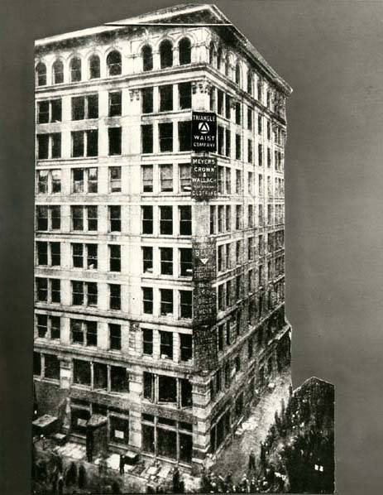

Slide 16
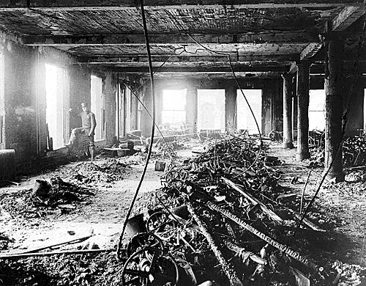

Slide 17
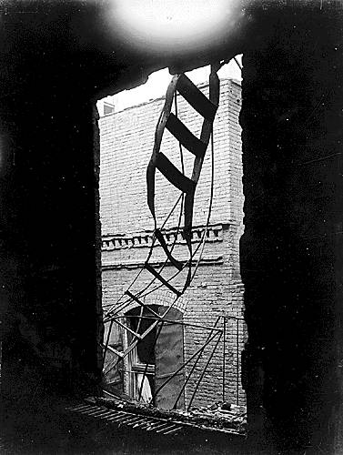
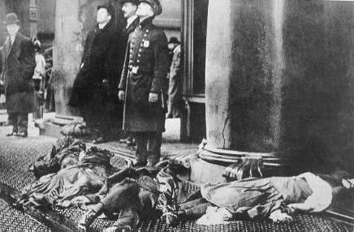

Slide 18
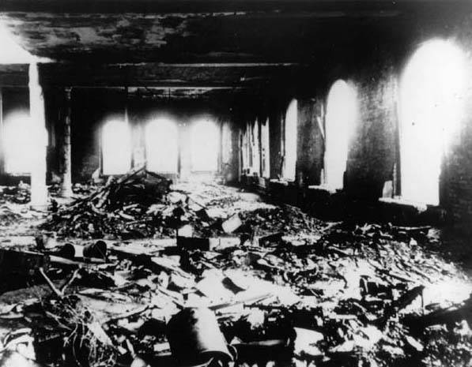

Slide 19
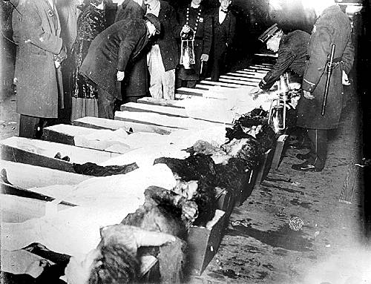

Slide 20
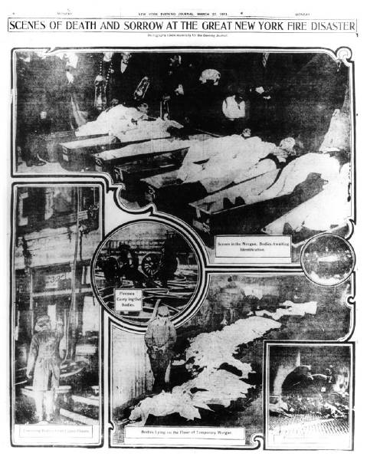

Slide 21
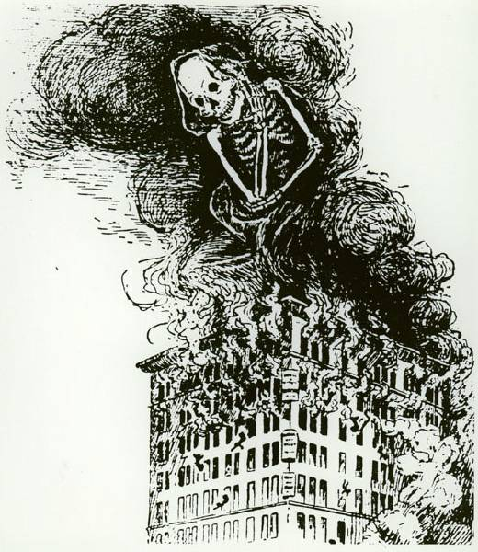

Slide 22
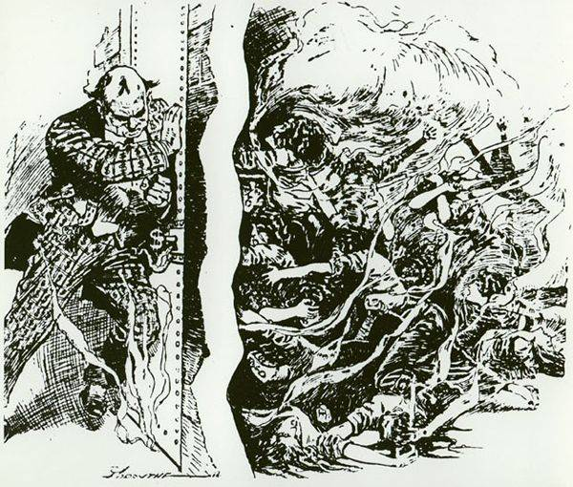

Slide 23
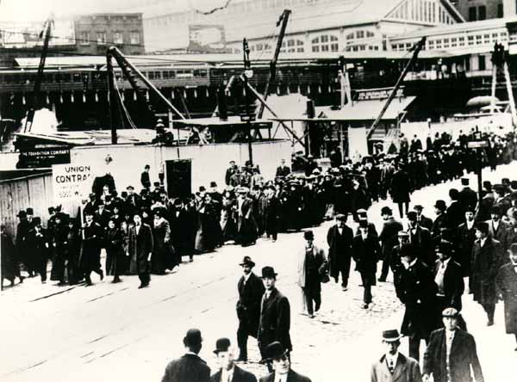
Protestors March to City Hall

Slide 24
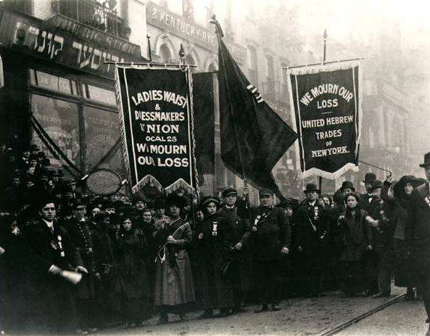
Labor Unions March as Mourners

Slide 25
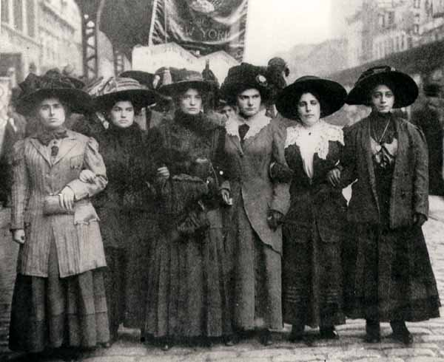
Women workers march to city hall

Slide 26
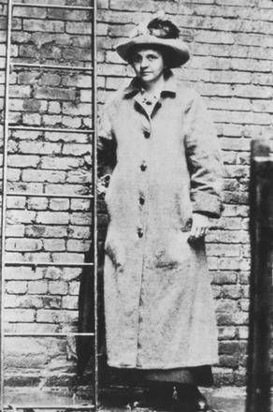
Frances Perkins (future Secretary of Labor)

Slide 27
Results:
Union membership increases
NYC created a Bureau of Fire Prevention.
New strict building codes
Tougher fire inspection of sweatshops.
Increased support for women’s suffrage.

Slide 28
Labor Reforms & the Supreme Court
Lochner v. New York
Sided w/ business
Overturned law mandating 10 hr workday
Muller v. Oregon
Upheld 10 hr workday law for women
Brandeis brief
Buntinn v. Oregon
Extended 10 hr workday to men in factories

Slide 29
Labor Unions Take Action
ILGWU (International Ladies’ Garment Workers’ Union)
Uprising of 20,000
Won shorter work week & higher wages
IWW (Industrial Workers of the World; “Wobblies”)
Anti- capitalism
“Big Bill” Haywood
Traditional & radical tactics
Gov’t. crackdown destroyed union

Slide 30
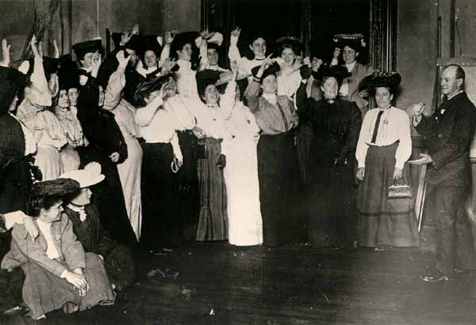
Women voting for a strike

Slide 31
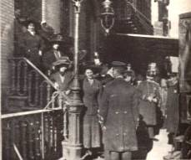
Arresting female strikers

Slide 32
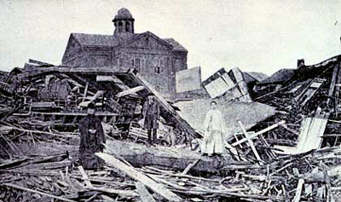
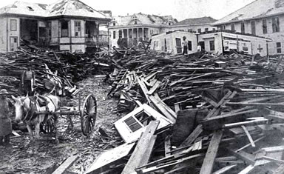
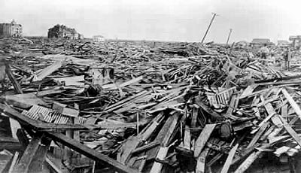
Galveston Hurricane, 1900

Slide 33
Government Reforms:
Improved municipal services
sewage, health, utilities, transportation, police, fire
New York, Tenement Act of 1901
Tom Johnson—Cleveland, OH
Hired city managers
Idea from Texas following Galveston Hurricane
Wisconsin Ideas
Robert LaFollette
Direct primaries, limited campaign spending, railroad & transportation regulations, civil service & taxation

Slide 34
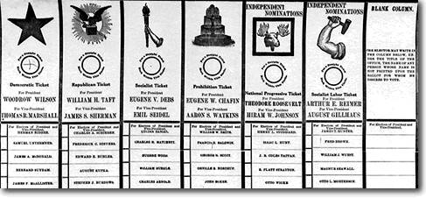
Voting Reforms:
17th amendment
Initiatives
Referendums
Recalls
Secret ballot
Direct primaries

Slide 35
Fighting Discrimination:
ADL (Anti Defamation League)
Fought prejudice against Jewish people (anti-Semitism), esp. stereotypes in media

Slide 36
NAACP (National Organization for the Advancement of Colored People)
Fights for African American rights
Against segregation in government
Against movie: A Birth of a Nation
Brownsville Incident
Situation worsens under Wilson
Against anti lynching laws
Permits segregation
Permits law outlawing black-white marriages

Slide 37
Brownsville Incident
1906 Brownsville, TX
Unit of African American soldiers wrongly accused of violence
Several arrested
Entire unit dishonorably discharged
6 were Medal of Honor recipients

Slide 38
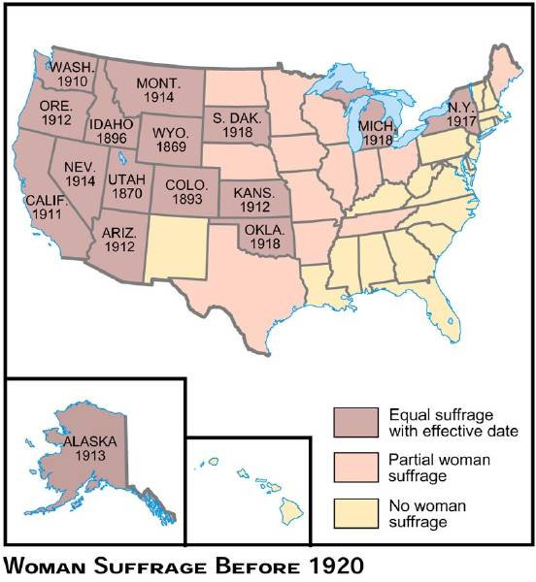
Women's Suffrage before 1920:

Slide 39
Limitations for Women
Few African Americans could go to college
NACW(National Association of Colored Women)
Ida B. Wells
Alberta Virginia Scott, Otelia Cromwell
Many professions off limits (ex. American Medical Association)
Female factory workers paid less than men

Slide 40
Opportunities Available for Women
Education
Many upper & middle class attend college
Workforce
Teachers, nurses, secretaries, bookkeepers, typists, shop clerks, journalists, artists
Factory jobs for working class

Slide 41
2 Major Suffragist Groups
NWSA (National American Women’s Suffrage Association)
Elizabeth Cady Stanton & Susan B. Anthony
Constitutional amendment
AWSA (American Women’s Suffrage Association)
Henry Ward Beecher
State by state campaign
Aligned w/ Republican Party

Slide 42
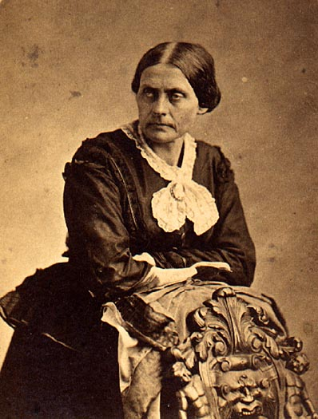
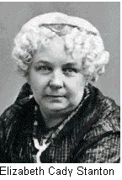
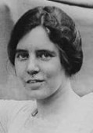
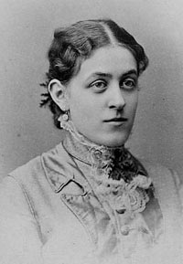
Suffragettes:
Susan B. Anthony
Elizabeth Cady Stanton
Carrie Chapman Catt
Alice Paul

Slide 43
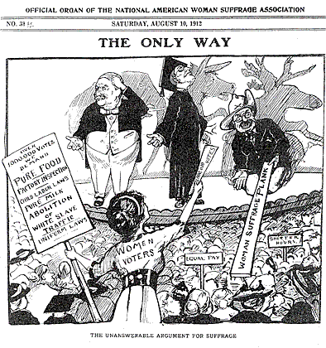

Slide 44
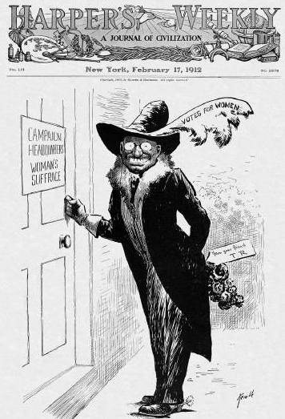
T. Roosevelt & Women's Suffrage:

Slide 47
Arguments against Women’s Suffrage:
Social
Too fragile, uneducated
Interfere w/ family duties
Economic
Distillers & other business owners
Religious
Husband represented entire family

Slide 49
Not even all women were in favor of suffrage

Slide 50
Women’s Suffrage:
19th amendment
“Perfect 36”

Slide 51
Other Reform movements
Prohibition (18th Amendment)
Ban on manufacture, sale & consumption of alcohol
Anti Saloon League
Women’s Chritsian Temperance Union
Frances Willard
Carrie Nation & Billy Sunday (evangelists)
Settlement houses
Jane Addams, Hull House
Children’s issues
Lillian Wald
Federal Children’s Bureau

Slide 52
McKinley’s Assassination
September 6, 1901, at the Temple of Music in Buffalo, New York.
Pres. McKinley was attending the Pan-American Exposition
shot twice by Leon Czolgosz, an anarchist
Congress places secret service in charge of protecting presidents

Slide 53
Pres. Theodore Roosevelt:
Governor of NY
Vice pres. to McKinley
bully pulpit
Square Deal
Attempted to balance labor, consumer & business
Pres. Roosevelt speaking to a crowd in Asheville, NC

Slide 54
Trust busting:
Trusts competed unfairly, sold inferior products & corrupted public officials
Elkins Act
Hepburn Act
“Big Business Requires Big Government”

Slide 55
Protecting the Consumer
Muckrakers
Upton Sinclair The Jungle
Meat Inspection Act
Pure Food and Drug Act

Slide 57
Pres. Roosevelt & Conservation:
Realizes limits of resources & interests of businesses harm environment
Est. forest reserves
Newlands Reclamation Act

Slide 58
Pres. Roosevelt & Conservation:
Est. national parks
Works w/ Gifford Pinchot
Coins word conservation

Slide 61
President Taft
Extended power of ICC
Mann-Elkins Act
Added to forest reserves
Created Dept. of Labor
Passed labor-safety laws
16th Amendment

Slide 62
Taft loses support:
Payne-Aldrich Tariff
High tariff
Ballinger-Pinchot affair
Taft fires Pinchot, makes T. Roosevelt enemy

Slide 63
Conservation Issue: The Ballinger-Pinchot Affair

Slide 65
Election of 1912:
Division of Rep. Party
Taft’s performance
Ballinger-Pinchot affair
Attack on Joseph Cannon
Rep. who refused to vote for Taft voted for Dem. Woodrow Wilson

Slide 66
The Bull-Moose Party:

Slide 67
The Anti-Third Term Principle

Slide 68
Division of GOP by Bull Moose Party = Victory for the Democrats

Slide 69
Election of 1912

Slide 70
Up Against the Hurdles:

Slide 71
Wilson's New Freedom:
Tariff reform
Banking reform
Business reform
Labor help

Slide 72
Tariff Reform
Helped farmers
Cost revenue, but this was made up through income tax

Slide 73
Banking reform:
Created “bankers” banks
Stabilized the banking system
Helped small farmers gain access to lower interest rates

Slide 74
Business Reform:
Extended the 1890 Sherman Antitrust Act
Helped the government regulate monopolies

Slide 75
Farmers & Laborers
Federal Farm Loan Act
Low-interest loans to farmers
Adamson Act
Reduced workday for RR workers
Keating-Owen Child Labor Act
Tried to reduce child labor (declared unconstitutional by Supreme Court)

